Slide 1
Chicago Bungalow
Restoration & Rehab “before & after”

Slide 2
The outcome of my vision.
My vision was to restore the front exterior of the building maintaining the original architectural lines while doing a full interior rehabilitation. I would retain and re-purpose as much of the building as possible, restore the look and feel of the period while creating an open plan on the first-floor, increase and improve the second-floor use of space, and include all new modern amenities.
As the designer and GC, I took the building from a two bedroom one bath to a 4 bed, 3.5 bath while maintaining the exterior look of the 1.5 story bungalow. It has the benefits of all new construction but the look and feel of years past. It maintains the bungalow style and look while boasting an open floor plan of living, dining and kitchen areas, and a fireplace, a 1st floor master bedroom on-suite that opens to a sun room, original oak wood floors, replicated oak trim, doors and cabinetry, period lighting and a few unique elements. Two 2nd floor large and unique dormered bedrooms with a full bath and a 4th bedroom and bath in the lower level. Newly landscaped yard, large deck for entertaining and two car garage. All new mechanicals including a new copper pipe water service, zoned heating and cooling and 200-amp electrical service.

Slide 3
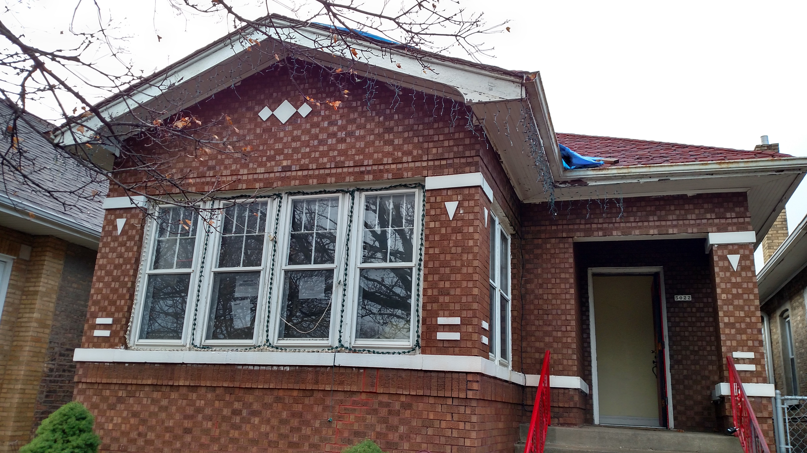
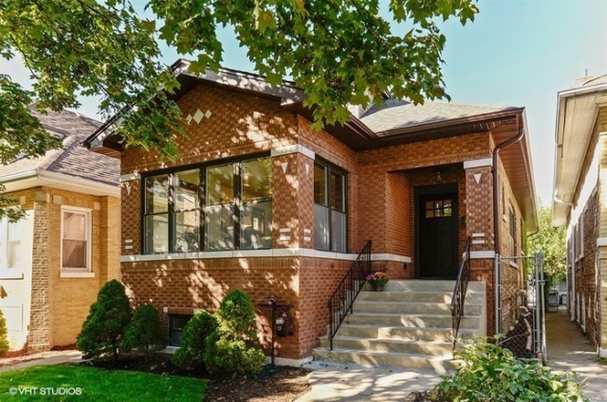
Building Front
Before
After

Slide 4
Living Room
Before
After

Slide 5
Front Room
Before
After

Slide 6
Dining Room
Before
After

Slide 7
Kitchen
Before
After

Slide 8
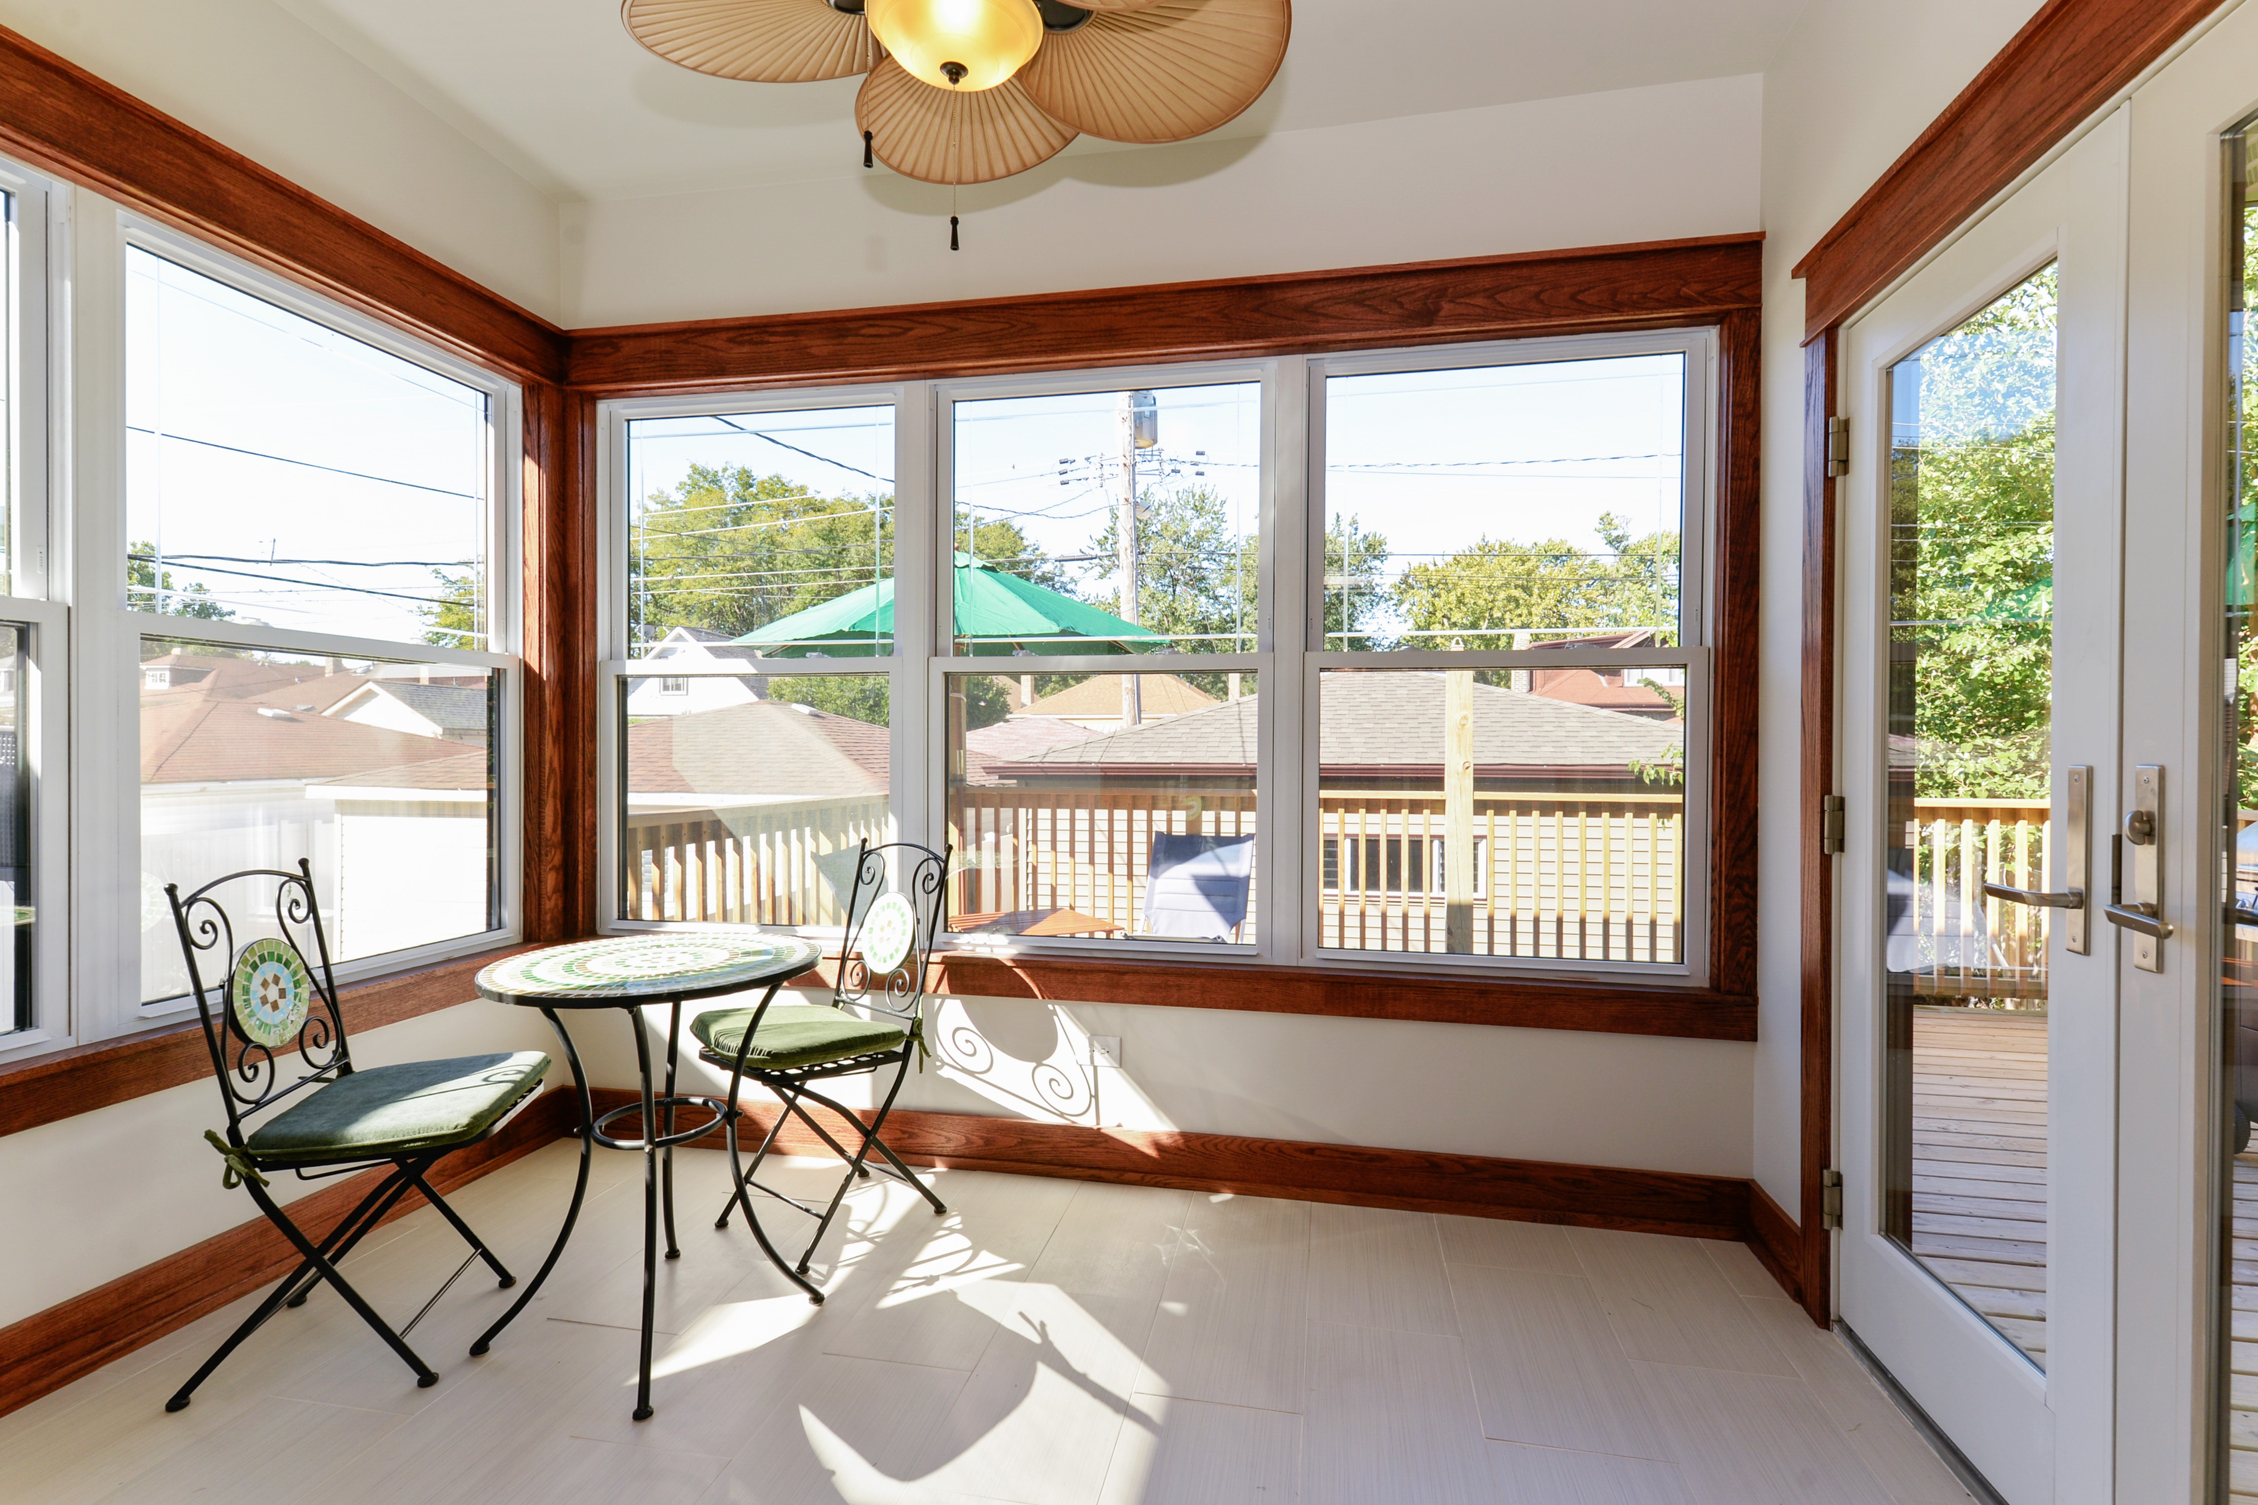
Bedroom to Master ensuite
Before
After

Slide 9
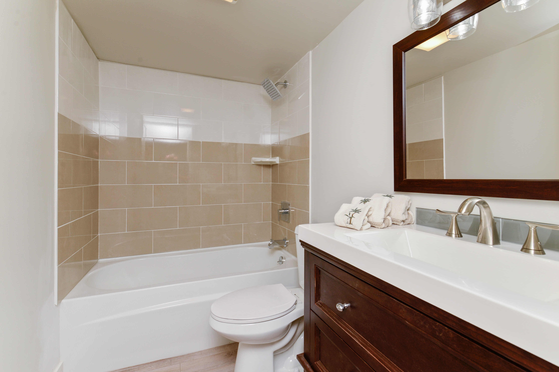
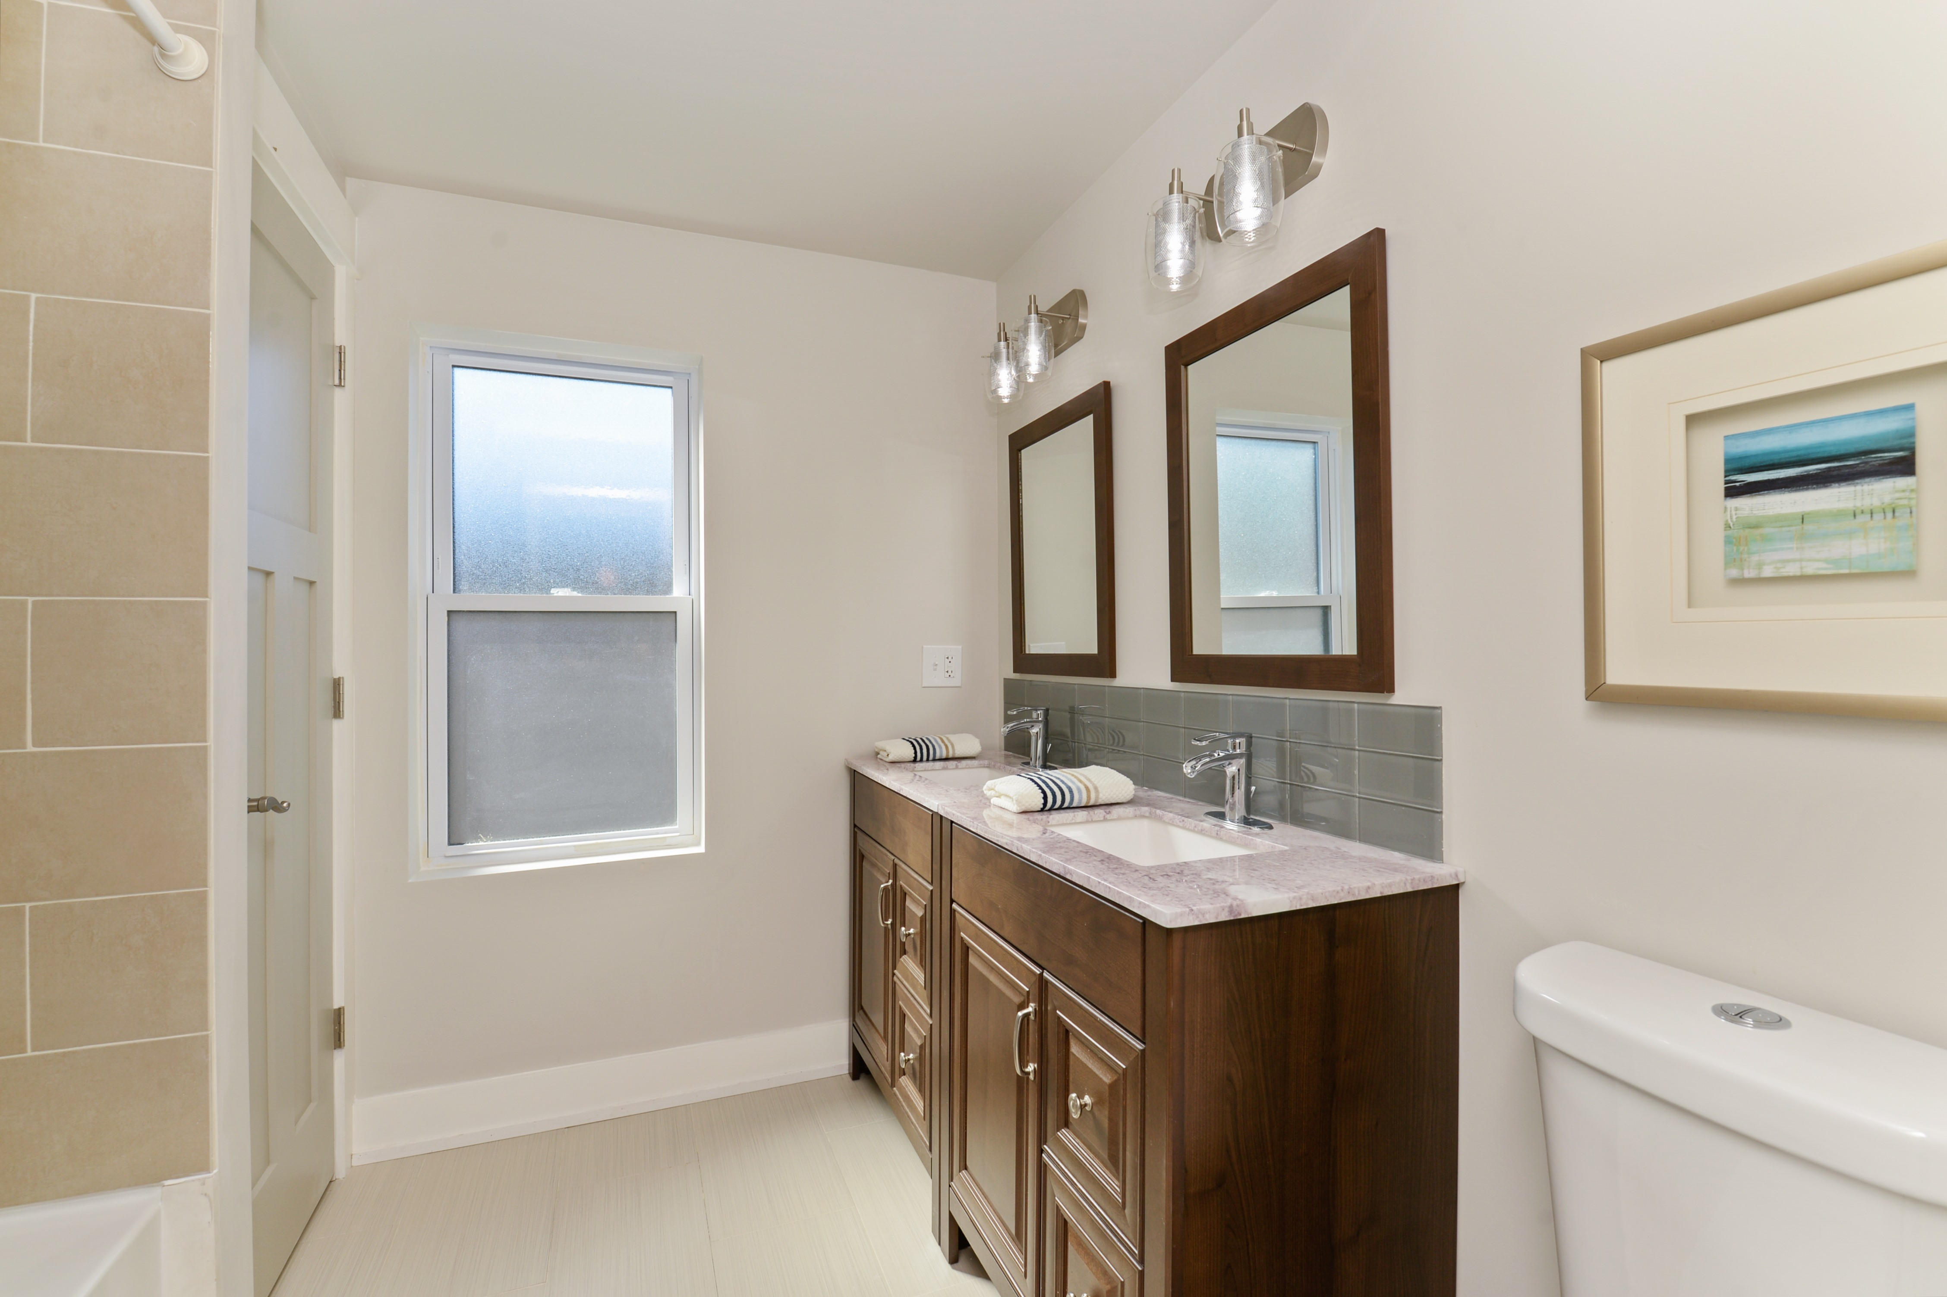
Bathroom
Before
After

Slide 10
2nd floor front bedroom
Before
After

Slide 11
2nd floor rear bedroom
Before
After

Slide 12
basement
Before
After

Slide 13
basement
Before
After

Slide 14
Building Rear
Before
After

Slide 15
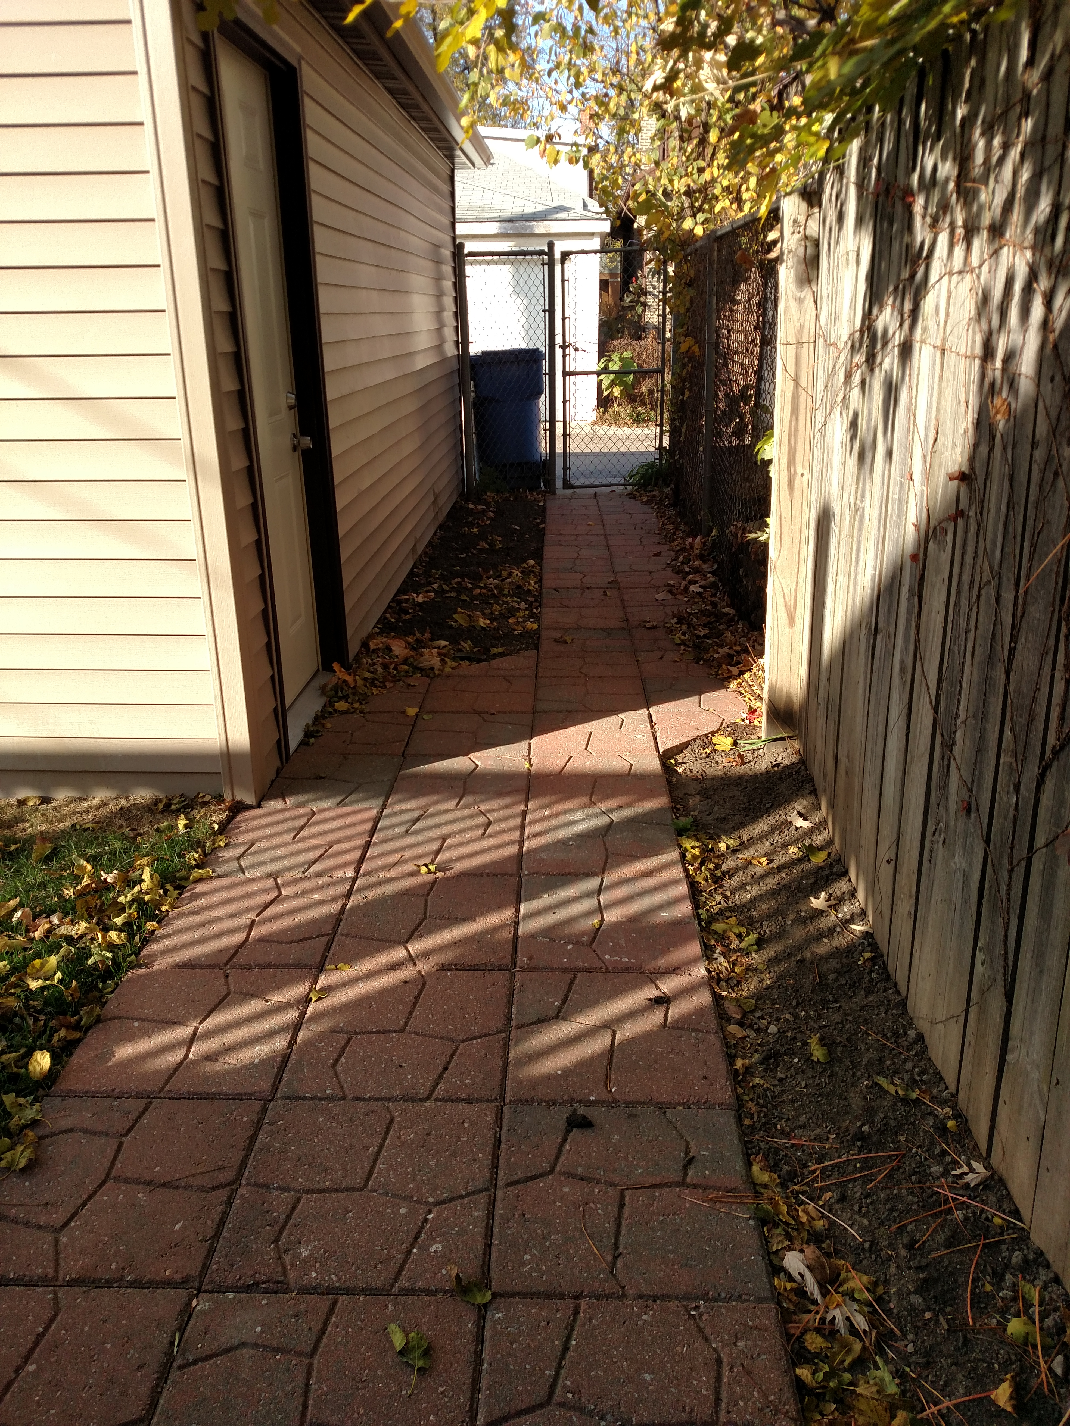
Walkway
Before
After
Before
After

Slide 16
Foyer/ entry
Before
After

